Slide 1
Information Governance
Speaker Name

Slide 3
Objectives
After completing this section, you will:
Understand key concepts of how data Retention policies, and Retention Labels, can help organizations impose additional layers of data security, governance, and protection, to content that is stored in SharePoint Online and OneDrive for Business
Understand the subscription and licensing requirments for these features and services

Slide 4
Retention Policies

Slide 5
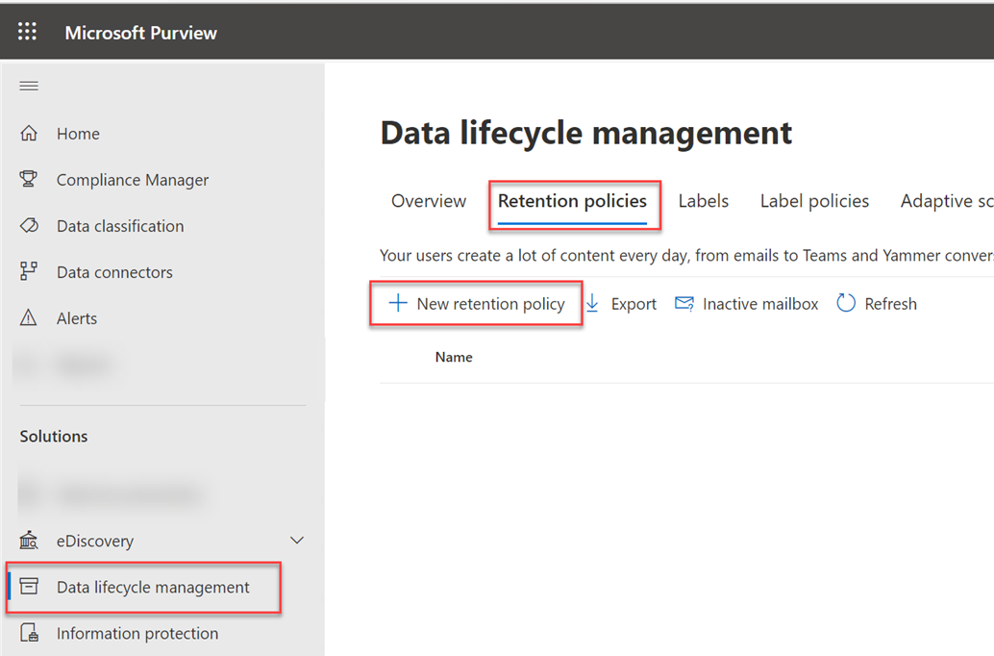
The Microsoft 365 Compliance Center
Use the M365 Compliance Center to provision and configure Retention policies, retention Labels, and Label policies
By default, SharePoint Online Administrators do not have access to the M365 Compliance center
Requires close collaboration between SPO admins and security and compliance admins in order to meet security requirements and obligations
Notes:
The Microsoft 365 security and compliance center is rolling out now. Once deployed, administrators can login as they usually do, or navigate to https://protection.microsoft.com to try out the new security and compliance experiences. In addition, they can also navigate to the Microsoft 365 security and compliance center from the Microsoft 365 admin center .
See https://techcommunity.microsoft.com/t5/Security-Privacy-and-Compliance/Introducing-the-Microsoft-365-Security-and-Compliance-Center/ba-p/178468
The features and settings available in the M365 CC depend on the level of Microsoft 365, Azure Premium, and Enterprise Mobility + Security, subscriptions you have
For more information on Security and Compliance Center features see
https://docs.microsoft.com/en-us/office365/servicedescriptions/office-365-platform-service-description/office-365-securitycompliance-center#security--compliance-center-availability-for-standalone-plans
Data governance enables users to create, publish, and manually apply labels to documents; import data using drive shipping or over the network; and create and apply retention/deletion policies across workloads, users, and groups. Retention policies applied to mailboxes require Microsoft 365 Enterprise E3 or E5.
Advanced data governance allows you to retain important information and delete unimportant information by classifying information based on a retention or deletion policy or both. It includes intelligent/automated actions such as recommending policies, automatically applying labels to data, applying labels based on sensitive data types or queries, disposition review, and use of smart import filters.
Advanced eDiscovery is supported in the United States and in the Western Europe (Netherlands) region. (Customer data from Canada and Asia Pacific is exported to the United States. Customer data from Europe, the Middle East, and Africa is exported to Western Europe [Netherlands].)
Advanced Threat Protection is available in Microsoft 365 Enterprise E5 and as a standalone service for Microsoft 365 Enterprise E1 and Microsoft 365 Enterprise E3.

Slide 6
What are Retention Policies
Retention policies allow for organizations to effectively manage and govern information requirements including:
Comply proactively with industry regulations and internal policies that require you to retain content for a minimum period of time.
Reduce your risk in the event of litigation or a security breach by permanently deleting old content that you’re no longer required to keep.
Help your organization to share knowledge effectively and be more agile by ensuring that your users work only with content that’s current and relevant to them.

Slide 7
Retention Actions
Managing content through retention requires the effective use of one or both actions below:
Retention - Retaining content so that it can’t be permanently deleted before the end of the retention period.
Deletion - Deleting content permanently at the end of the retention period.
Through these actions you can accomplish many compliance requirements including:
Decide proactively whether to retain content, delete content, or retain and then automatically delete the content.
Apply a single policy to the entire organization or just specific locations or users.
Apply a policy only to content meeting certain conditions, such as specific keywords or specific types of sensitive information

Slide 8
Retention Locations
One of the most powerful features of a retention policy is that by default it applies to locations across Microsoft 365, including:
SharePoint sites
OneDrive for Business sites
Exchange email
Microsoft 365 Groups
Content stored in group’s mailbox, site, and documents
Teams channel messages and Teams chats
Exchange Public Folders
Teams Channel Messages and Chats
Support for content stored in Planner, Yammer and CRM is coming soon

Slide 9
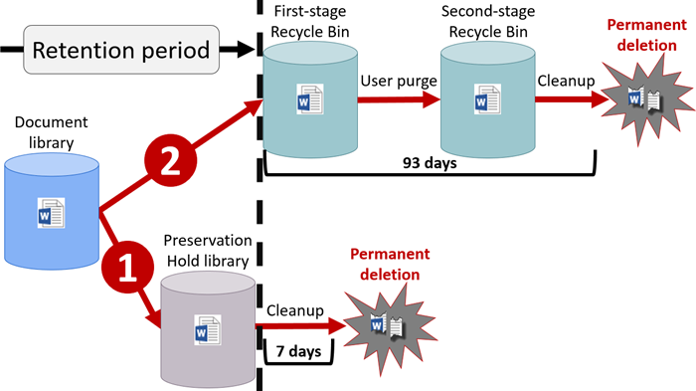
How Retention Policies Impact Content in SharePoint and OneDrive
A retention policy is applied at the level of a site. When you include a SharePoint site or OneDrive account in a retention policy, a Preservation Hold library is created, if one doesn’t already exist. Most users can’t view the Preservation Hold library because it’s visible only to site collection administrators.
Notes:
Reference Material:
When content is subject to a retention policy, people can continue to edit and work with the content as if nothing's changed because the content is retained in place, in its original location. But if someone edits or deletes content that's subject to the policy, a copy is saved to a secure location where it's retained while the policy is in effect.
After a retention policy is assigned to a OneDrive account or SharePoint site, content can follow one of two paths:
If the content is modified or deleted during the retention period, a copy of the original content as it existed when the retention policy was assigned is created in the Preservation Hold library. There, a timer job runs periodically and identifies items whose retention period has expired, and these items are permanently deleted within seven days of the end of the retention period.
If the content is not modified or deleted during the retention period, it’s moved to the first-stage Recycle Bin at the end of the retention period. If a user deletes the content from there or empties this Recycle Bin (also known as purging), the document is moved to the second-stage Recycle Bin. A 93-day retention period spans both the first- and second-stage recycle bins. At the end of 93 days, the document is permanently deleted from wherever it resides, in either the first- or second-stage Recycle Bin. Note that the Recycle Bin is not indexed and therefore searches do not find content there. This means that an eDiscovery hold can't locate any content in the Recycle Bin in order to hold it.

Slide 10
How Retention Policies Impact versions in SharePoint and OneDrive
Versioning is enabled on all document libraries in SharePoint Online and ODFB sites.
If a document is deleted from a site that’s being retained, all versions of the deleted document are retained.
When an item is subject to several retention policies, the version that’s retained is the one that’s current when each retention policy takes effect.

Slide 11
Retention policies override the OneDrive deletion process
By default, the OneDrive deletion process is initiated when a user account is deleted from the Microsoft 365 admin center or is removed through Active Directory synchronization
The user account deletion is synchronized to SharePoint Online
The OneDrive Clean Up Job runs, and the deleted users OneDrive is marked for deletion. The default retention period for OneDrive is 30 days
Retention policies always take precedence so content included in a Retention policy could be deleted before 30 days or retained for a longer period of time depending on the Retention policy setting.
Notes:
NOTE: The retention policies do NOT apply until AFTER the default retention for OneDrives has concluded. E.g. If the default retention is still 30-days and the retention
policy is set for 1 year. The ODB will not be deleted until 13 months after the user was deleted.
For more information on the ODFB automatic deletion process see
OneDrive retention and deletion https://docs.microsoft.com/en-us/onedrive/retention-and-deletion

Slide 12
What can be replaced with Retention Policies?
SharePoint and OneDrive for Business
Holds created for eDiscovery in the Security & Compliance Center (eDiscovery hold)
Holds created in the eDiscovery Center (eDiscovery hold)
Document deletion policies (Deletion only)
In place records management (Retention)
Site closure and deletion policies (Deletion only)
Information management policies (Deletion only)

Slide 13
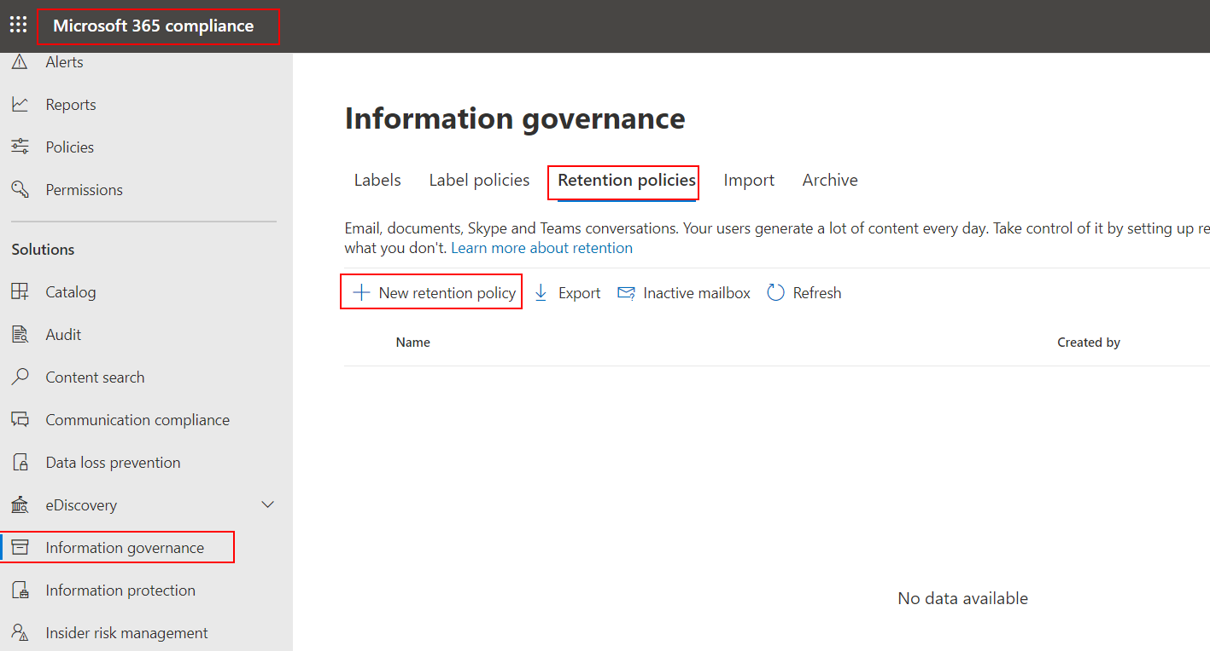
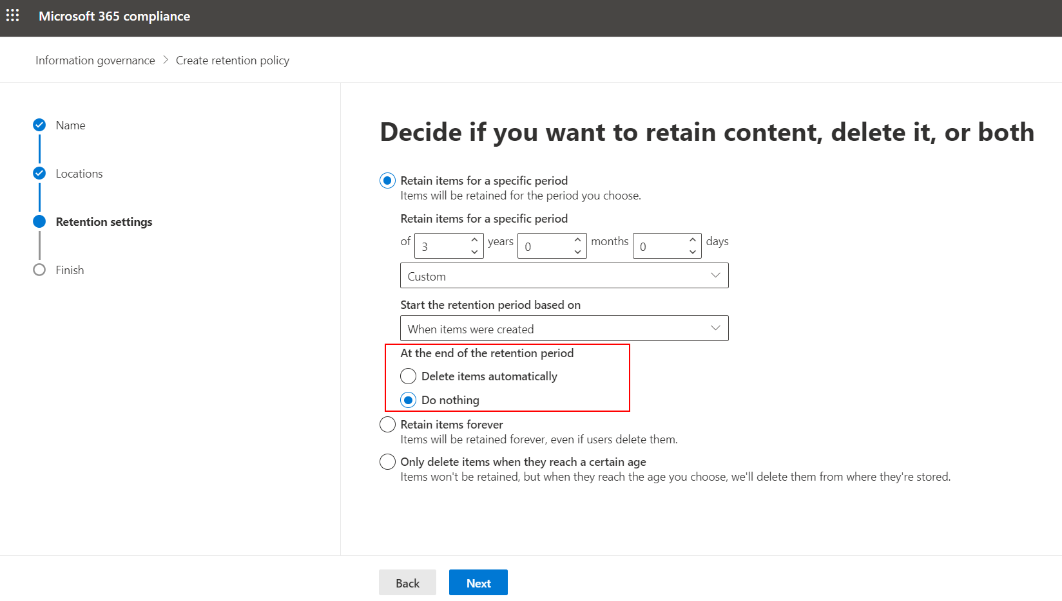
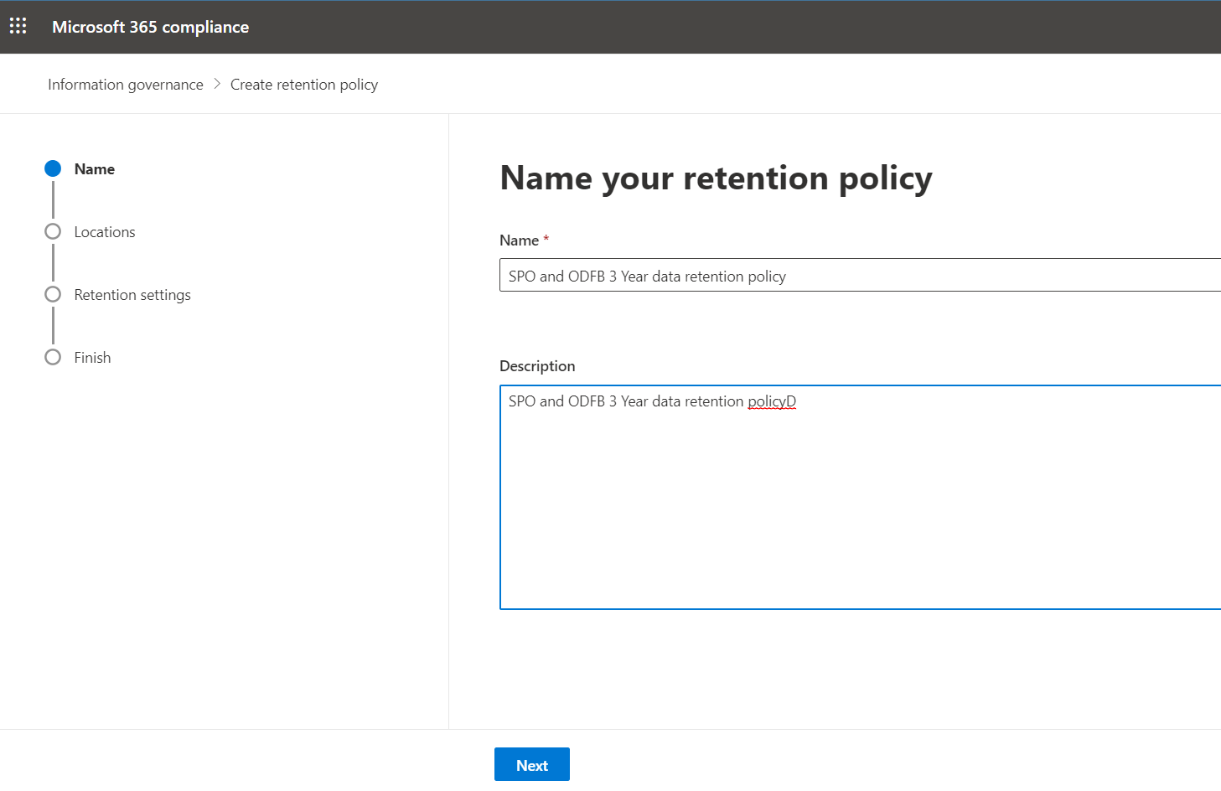
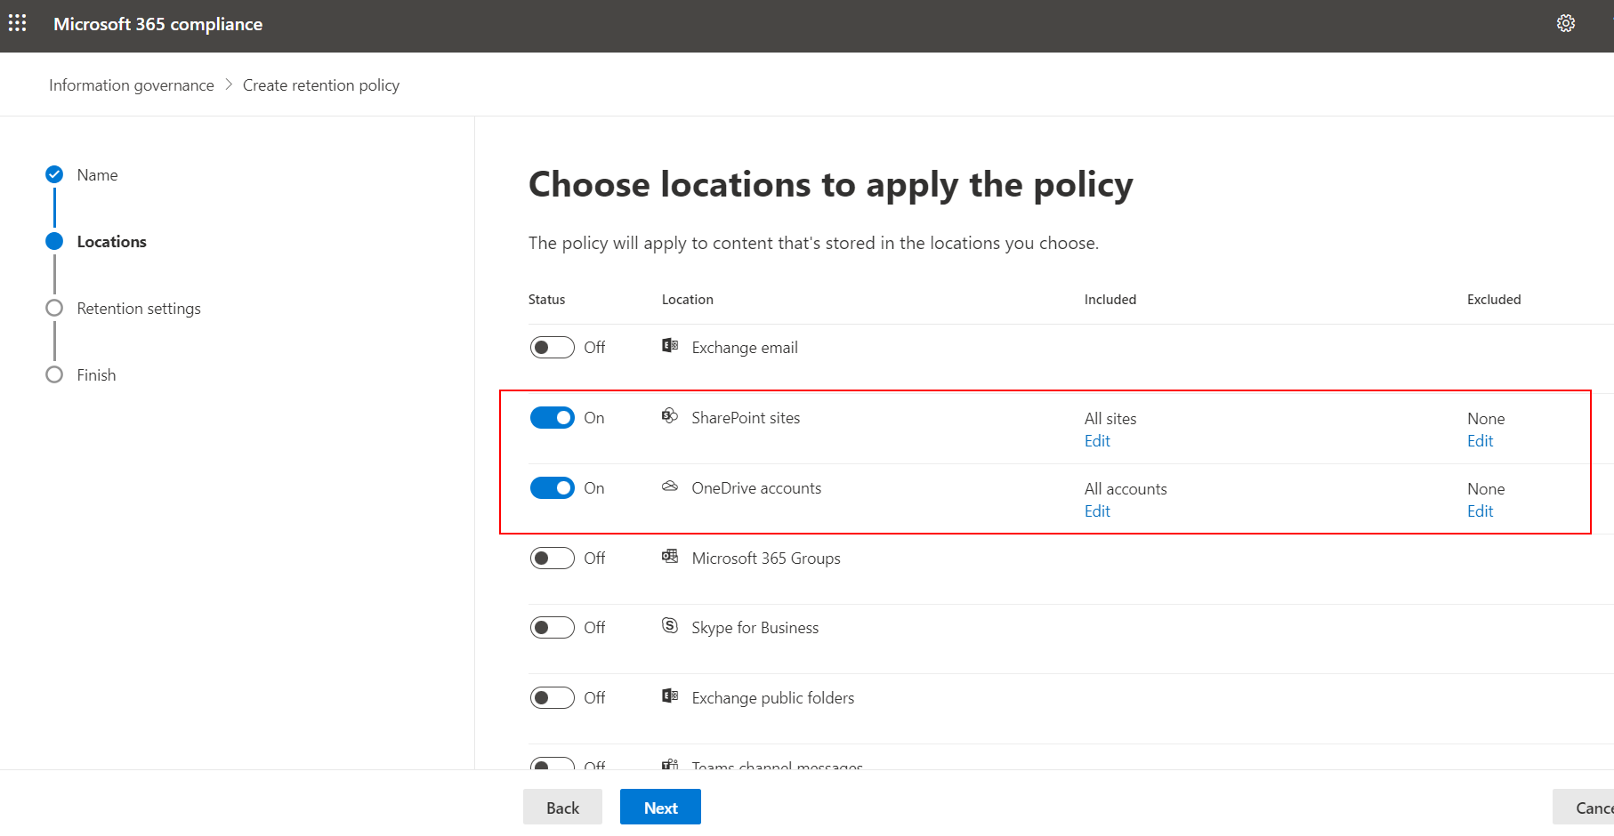
Create a Retention Policy

Slide 14
Retention Labels

Slide 15
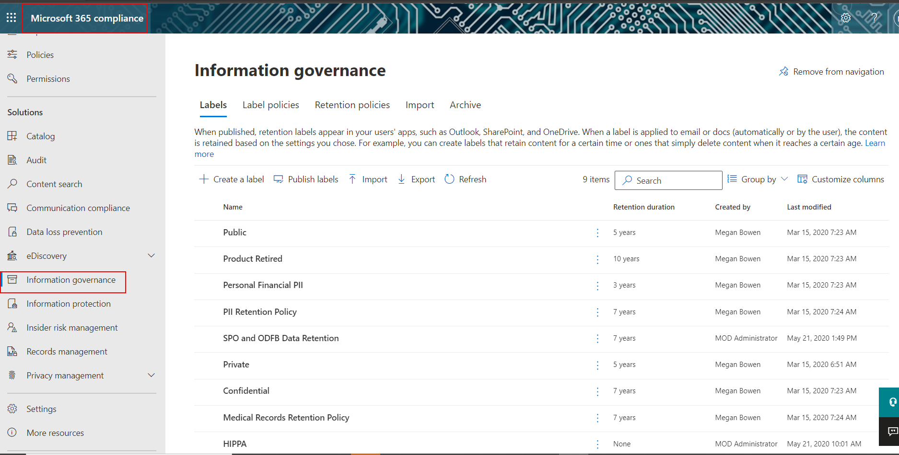
What Retention Labels can do
Enable people in your organization to apply a label manually
Apply labels to content automatically*
Apply a default label to a document library
Implement records management across Microsoft 365
Require disposition when retention is completed
* Auto-apply labels require a Microsoft 365 Enterprise E5 subscription.

Slide 16
Retention Labels – Process flow
Admin
Creates a label
Publishes the label to locations selected in a label policy
End User
Works on a document and sees the available labels
Classifies the document by applying a label
Microsoft 365
Enforces retention rules on the document based on the applied label

Slide 17
Retention Label Policies and Locations
If the label is… | Then the label policy can be applied to…
Published to end users | SharePoint, OneDrive, Microsoft 365 groups, Exchange
Auto-applied based on sensitive information types* | SharePoint, OneDrive
Auto-applied based on a query* | SharePoint, OneDrive, Microsoft 365 groups, Exchange
*Auto-apply labels require an Microsoft 365 Enterprise E5 subscription.
Notes:
Different types of labels can be published to different locations, depending on what the label does.
PS.: Note that Exchange public folders and Skype do not support labels.

Slide 18
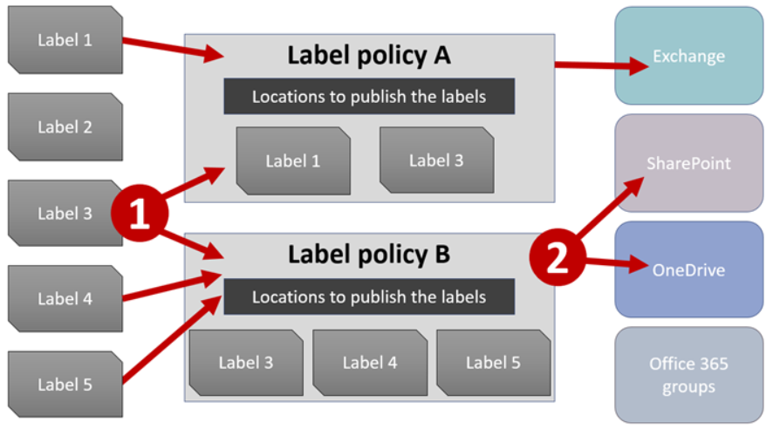
How Labels work
Notes:
Labels are independent, reusable building blocks that are included in a label policy and published to different locations. Labels can be reused across many policies. The primary purpose of the label policy is to group a set of labels and specify the locations where you want those labels to appear.

Slide 19
How Labels Work
A document in SharePoint Online can have only a single retention label assigned
A document can also have a single retention label and a single sensitivity label assigned
For labels assigned manually by end users, people can remove or change the label that’s assigned pending you have the permissions to do so.
If content has an auto-apply label assigned, an auto-apply label can be replaced by a label assigned manually by an end user.
If content has a label assigned manually by an end user, an auto-apply label cannot replace the manually assigned label.
If there are multiple rules that assign an auto-apply label and content meets the conditions of multiple rules, the label for the oldest rule is assigned.

Slide 20
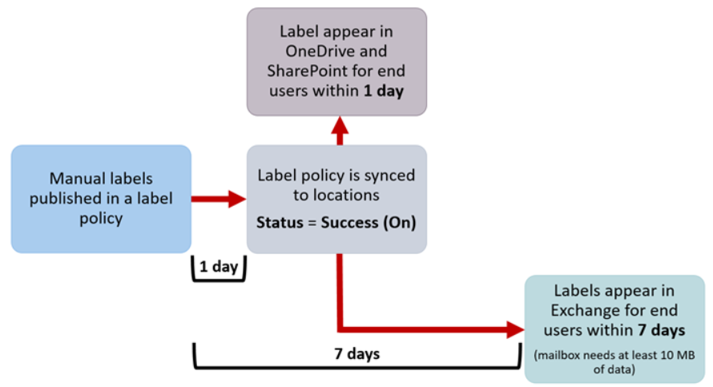
Manual Labels
Notes:
If you publish labels to SharePoint or OneDrive, it can take one day for those labels to appear for end users. In addition, if you publish labels to Exchange, it can take 7 days for those labels to appear for end users, and the mailbox needs to contain at least 10 MB of data.
When you publish or auto-apply labels, they don’t take effect immediately.
First the label policy needs to be synced from the Security & Compliance Center to the locations in the policy.
Next the location may require time to make manual labels available to end users or auto-apply labels to content. How long this takes depends on the location and type of label.
Manual labels
Auto-apply labels

Slide 21
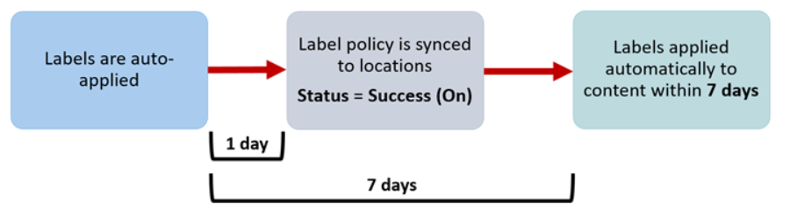
Auto-apply Labels
Requires E5 or E3 plus Microsoft 365 E5 Compliance, or E3 plus Microsoft 365 E5/A5 Info Protection & Governance NOTE: Microsoft 365 E5/A5 Info Protection & Governance requires [AIP Plan 1 or EMS E3] + [ Exchange Online, SharePoint Online or OneDrive for business]
Notes:
If you auto-apply labels to content matching specific conditions, it can take seven days for the labels to be applied to all content that matches the conditions.
When you publish or auto-apply labels, they don’t take effect immediately.
First the label policy needs to be synced from the Security & Compliance Center to the locations in the policy.
Next the location may require time to make manual labels available to end users or auto-apply labels to content. How long this takes depends on the location and type of label.
Manual labels
Auto-apply labels

Slide 22
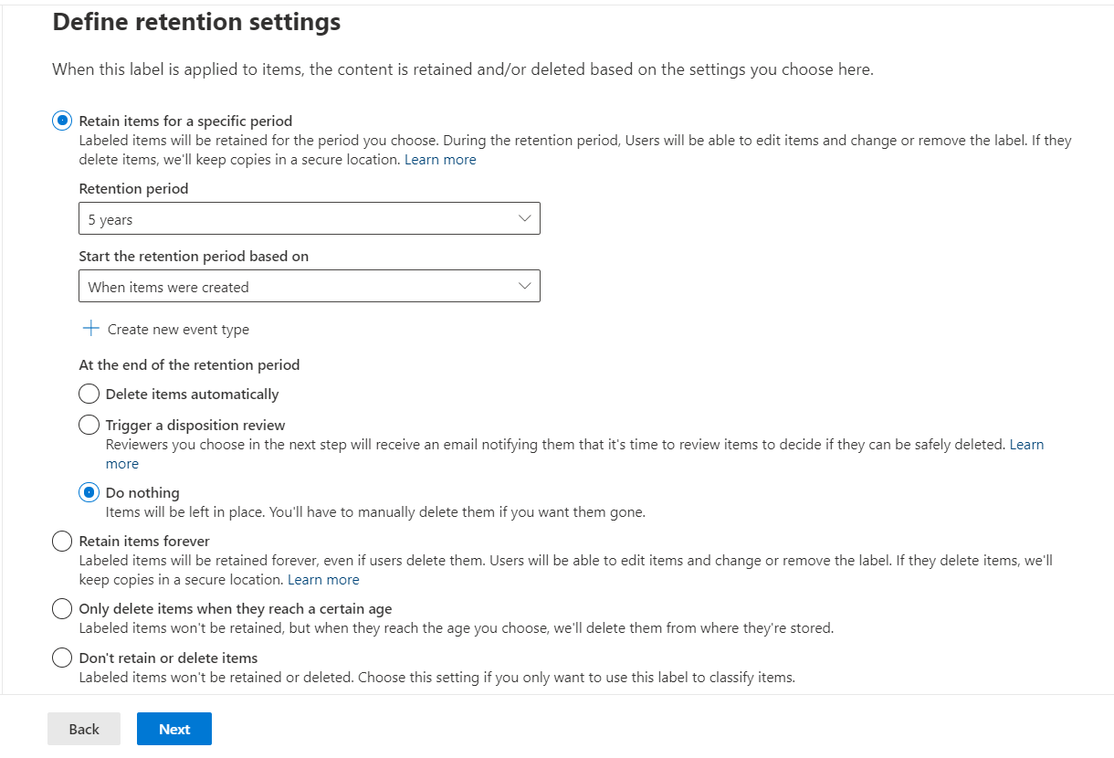
How Labels Enforce Retention
Labels enforce retention just like retention policies do.
They also share very similar capabilities in terms of how retention is configured for the items the label is added.
Labels can also be used to classify data (does not retain or delete)

Slide 23
Where Published Labels Can Appear To End Users
If your label will be manually assigned to content by end users, you can publish it to:
OneDrive and SharePoint Document libraries
Microsoft 365 groups (both the group site and group mailbox in Outlook on the web)
Outlook on the web
Microsoft 365 Apps for the Enterprise

Slide 24
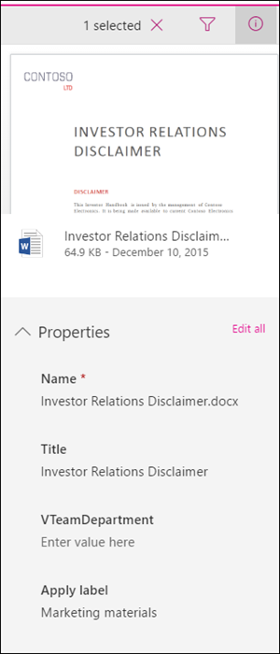
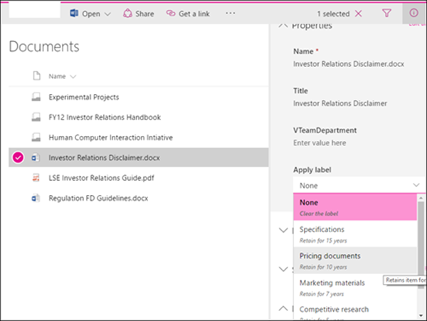
OneDrive and SharePoint
Label applied
Notes:
To label a document in OneDrive or SharePoint, select the item > in the upper-right corner, choose Open the details pane > Apply label > choose the label.
Note that you can apply a label to a folder or document set, and you can set a default label for a document library – see the section below for more information.

Slide 25
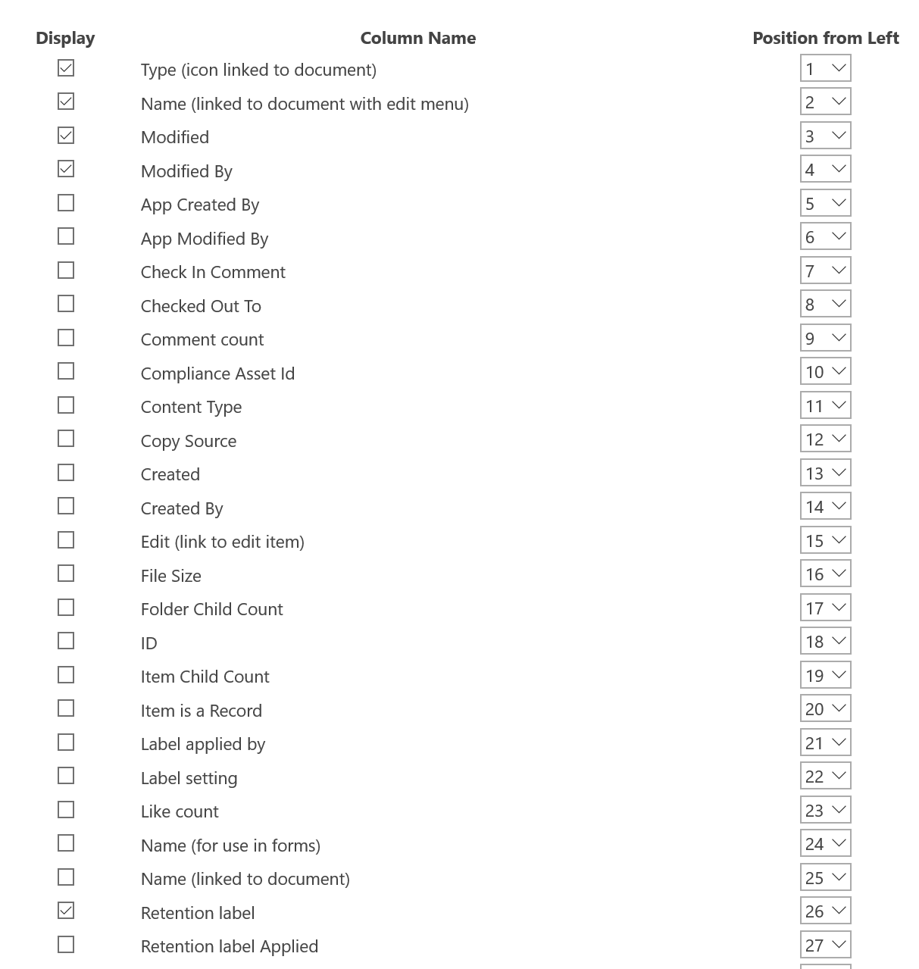
Create a View of the Library
You can modify the default view, or create a new view, of the library and add the Retention Label column to the view
This provides an easy way to see what label has been applied to documents in the library
Notes:
The Retention label column can be added to the view for the library.

Slide 26
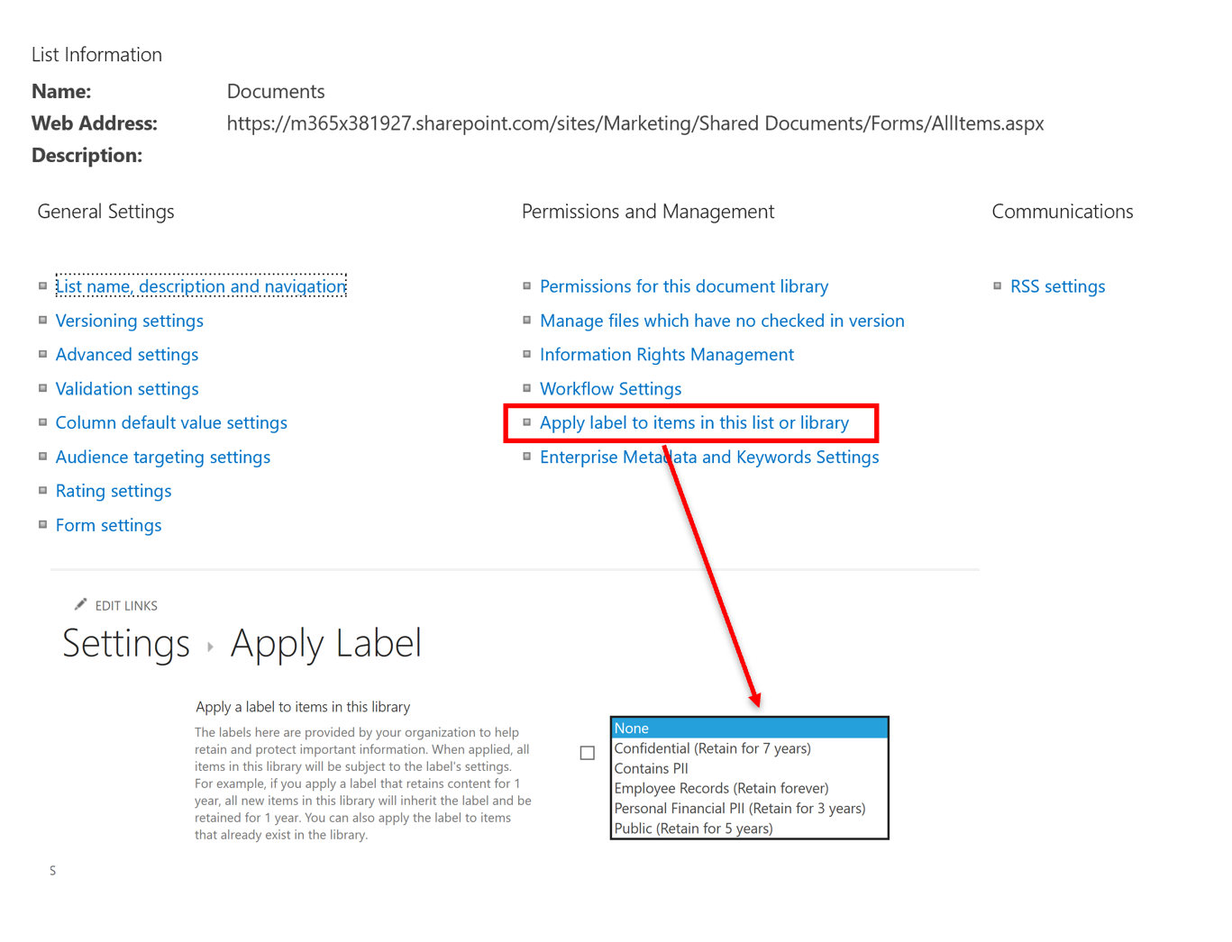
Applying a Label to All Content in a SharePoint Library
You can also apply a default label to a SharePoint library, so that all documents in that location get the default label.
If you want all current documents to automatically have the label applied to them, just check the additional box below the label selection dropdown.
Notes:
In addition to enabling people to apply a label to individual documents, you can also apply a default label to a SharePoint library, so that all documents in that location get the default label. This is done on the Library settings page for a document library. When you choose the default label, you can also choose to apply it to any existing items in the library.
For example, if you have a tag for marketing materials, and you know a specific document library will contain only that type of content, you can make the Marketing Materials tag the default for all documents in that library.
1. All items in the library, folder, or document set automatically get the same retention label, except for items that have had a retention label applied explicitly to them. Explicitly labeled items keep their existing label. (For more information, see the below section on The principles of retention, or what takes precedence?.)
2. If you change or remove the default retention label for a library, folder, or document set, the retention label is also changed or removed for all items in the library, folder, or document set, except items with explicit retention labels.
3. If you move an item with a default retention label from one library, folder, or document set to another library, folder, or document set, the item keeps its existing default retention label, even if the new location has a different default retention label.
(Source: https://docs.microsoft.com/en-us/office365/securitycompliance/labels#applying-a-default-retention-label-to-all-content-in-a-sharepoint-library-folder-or-document-set)

Slide 27
Principles of Retention - What Takes Precedence?
Retention wins over deletion
Longest retention period wins
Explicit inclusion wins over implicit inclusion
Shortest deletion period wins.
Notes:
It’s possible or even likely that content might have several retention policies applied to it, each with a different action (retain, delete, or both) and retention period. What takes precedence? At the highest level, rest assured that content being retained by one policy can’t be permanently deleted by another policy.
To understand how different labels with retention actions are applied to content, keep these principles of retention in mind:
Retention wins over deletion. Suppose that one retention policy says to delete Exchange email after three years, but another retention policy says to retain Exchange email for five years and then delete it. Any content that reaches three years old will be deleted and hidden from the users’ view, but still retained in the Recoverable Items folder until the content reaches five years old, when it will be permanently deleted.
The longest retention period wins. If content’s subject to multiple policies that retain content, it will be retained until the end of the longest retention period.
Explicit inclusion wins over implicit inclusion. This means:
If a label with retention settings is manually assigned by a user to an item, such as an Exchange email or OneDrive document, that label takes precedence over both a policy assigned at the site or mailbox level and a default label assigned by the document library. For example, if the explicit label says to retain for ten years, but the policy assigned to the site says to retain for only five years, the label takes precedence. Note that auto-apply labels are considered implicit, not explicit, because they’re applied automatically by Microsoft 365.
If a retention policy includes a specific location, such as a specific user’s mailbox or OneDrive for Business account, that policy takes precedence over another retention policy that applies to all users’ mailboxes or OneDrive for Business accounts but doesn’t specifically include that user’s mailbox.
The shortest deletion period wins. Similarly, if content’s subject to multiple policies that delete content (with no retention), it will be deleted at the end of the shortest retention period.
Understand that the principles of retention work as a tie-breaking flow from top to bottom: If the rules applied by all policies or labels are the same at one level, the flow moves down to the next level to determine precedence for which rule is applied.
Finally, a retention policy or label cannot permanently delete any content that’s on hold for eDiscovery. When the hold is released, the content again becomes eligible for the cleanup process described above.

Slide 28
Applying a Label Automatically Based on Conditions
Admin
Microsoft 365
Automatically applies the label to content that matches the specified conditions*
Assigns the label to locations selected in a label policy
Enforces retention rules on the content based on the applied label
Requires an Microsoft 365 Enterprise E5 subscription
Creates an auto-apply label
Notes:
One of the most powerful features of labels is the ability to apply them automatically to content that matches certain conditions. In this case, people in your organization don’t need to apply the labels – Microsoft 365 does the work for them.
PS.: Note that even though the ability to see and configure auto-apply labels is visible in the Security and Compliance Center, auto-apply labels requires an Microsoft 365 Enterprise E5 subscription, and that it can take up to seven days for auto-apply labels to be applied to all content that matches the conditions, as described above.

Slide 29
Applying a Label Automatically Based on Conditions
Auto-apply labels are powerful because:
You don’t need to train your users on all the classifications.
You don’t need to rely on users to classify all content correctly.
Users no longer need to know about data governance policies – they can focus on their work.
The following licenses provide the rights for a user to benefit from automatically applying retention labels or policies, applying default retention labels or policies, starting the retention period of a retention label based on a custom event
Microsoft 365 E5/A5/G5
Microsoft 365 E5/A5/G5/F5 Compliance and F5 Security & Compliance
Microsoft 365 Information Protection and Governance E5/A5/G5
Office 365 E5/A5
Notes:
PS.: Note that even though the ability to see and configure auto-apply labels is visible in uto-apply labels require an Microsoft 365 Enterprise E5 subscription, and that it can take up to seven days for auto-apply labels to be applied to all content that matches the conditions, as described above.

Slide 30
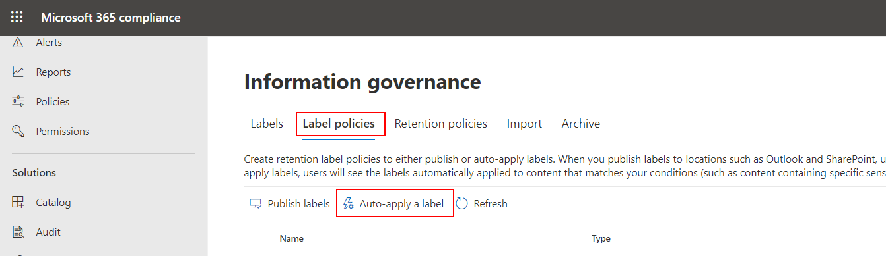
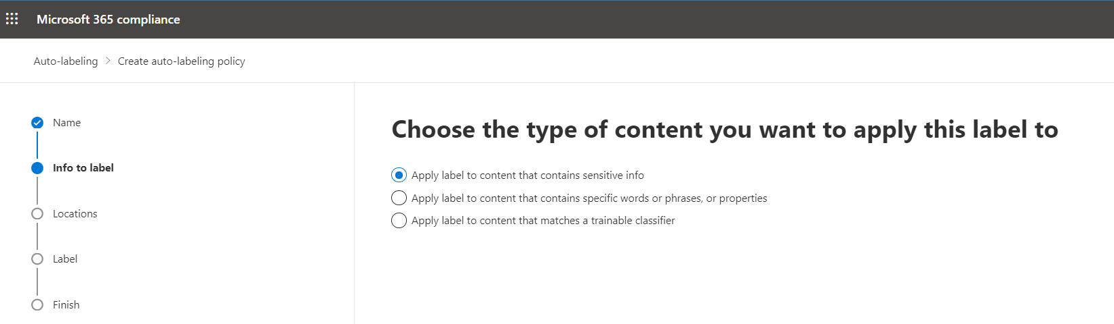
Applying a Retention Label Automatically Based on Conditions
You can choose to apply labels to content automatically when that content contains:
Specific types of sensitive information which are the same used with Data Loss Prevention policies.
Specific keywords that match a query you create
Notes:
PS.: Note that even though the ability to see and configure auto-apply labels is visible in auto-apply labels require an Microsoft 365 Enterprise E5 subscription, and that it can take up to seven days for auto-apply labels to be applied to all content that matches the conditions, as described above.

Slide 31
Knowledge Check
True/False: The ability to create and apply Retention Policies and Data Loss Prevention Policies is available in Microsoft 365 E3 and E5 tenants?
What are the key differences between Retention labels and Sensitivity labels?
The ability to auto-apply labels requires what level of Microsoft 365 subscription?
True – Retention and DLP policy features are available in O365 E3 and E5
Retention labels are used for retention, deletion, records management, archiving
Sensitivity labels are used to enforce encryption, restrict access, add watermarks, headers, and footers to documents
The ability to auto-apply labels requires an Microsoft 365 E5 subscription
Notes:
1. True/False: The ability to create and apply Retention Policies and Data Loss Prevention Policies is available in Microsoft 365 E3 and E5 tenants?
Answer: True – Retention and DLP policy features are available in O365 E3 and E5
What are the key differences between Retention labels and Sensitivity labels?
Answer:
Retention labels are used for retention, deletion, records management, archiving
Sensitivity labels are used to enforce encryption, restrict access, add watermarks, headers, and footers to documents
The ability to auto-apply labels requires what level of Microsoft 365 subscription?
Answer: The ability to auto-apply labels requires an Microsoft 365 E5 subscription

Slide 32
Summary
In this lesson, you learned how to:
Configure and use Retention policies, Labels (sensitive and retention labels), Data Loss Prevention policies, to provide addition layers of data security, protection, and governance, of content stored in SharePoint Online and OneDrive for business.

Slide 33
Lab M7
Exercise 2 -- Retention Policies
Exercise 3 -- Retention Labels
Exercise 4 -- Data Loss Prevention Policy
Exercise 5 -- Apply label to confidential content in SharePoint Online

